Slide 1
RHYMING WORDS
GRADE 1-ENGLISH
Presented by
. B. Jehanya
CLT Primary coordinator
SNS Academy
Grade1/English/Rhyming words/Jehanya .B 1/5
22.6.20202

Slide 2
Do you know what are rhyming words?
GRADE1 / ENGLISH-RHYMING WORDS / JEHANYA

Slide 3
RHYMING WORDS
Rhyming words are two or more words that have the same or similar ending sound. Some examples of rhyming words are: goat, boat, moat, float, coat.
When you are figuring out if two words rhyme, use your ears to listen as you say the words.
If they sound the same or similar, they rhyme.

Slide 4
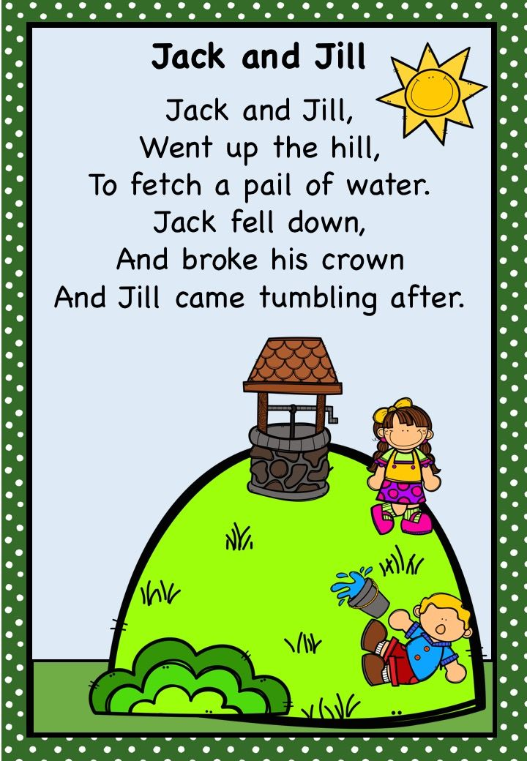

Slide 5
